Slide 1
WELCOME

Slide 2
MOVIES AND TV Series review system
Guided by: Jeena Varghese presented by:
varghese jojo
Vysakh Kannan
yadhu Krishnan p.j

Slide 3
content
ABSTRACT
INTRODUCTION
EXISTING SYSTEM
PROPOSED SYSTEM
ADVANTAGES
CONCLUSION
REFERENCE

Slide 4
Abstract
Movies and TV Series Review System is a website application aimed to rate and review movies and series. Films and series are playing major important role in an individual life. Good films always give us thoughts. Now a day’s people are eager to explore more about films and series. Our project introduces or explore more films and series. Every user can include their review about the movies they watch and rate it in webpage or can seek about the review of the movies or series. We also given an additional requirement which will help to remove the degrading of the movies and series.

Slide 5
Introduction
MSRS (Movies and TV series revies system) is online platform for reviewing movies and tv series.
There are 2 modules i.e.. Admin and user module
Admin module: Add movies and tv series details and also able manage users.
User module: users can add review and ratings for there favorite movie and tv series and also able to report the degrading of them.

Slide 6
Existing system
Before the introduction of the system people only use verbal promotions for there favorite movies and tv series .
There is nowhere to store or retrieve the review of particular favorite, people more often forget movie and tv series after watching.
So many movies and tv series has been passed without any public attention.

Slide 7
Proposed system
After developing this project the users are able to find there favorite movies as well as tv series and helps to makes Wishlist.
Also, provide facilities for storing the reviews and rating of there favorites.
Through this more movies as well as tv series are introduced among people.

Slide 8
ADVANTAGES
Find better movies and TV series for evening.
Rate and review your favorite and worst experienced movies and tv series.
Report the unauthorized degrading reviews.
Makes Wishlist.
Introduce more movies and tv series among people.

Slide 9
Data flow diagram (dfd)

Slide 10
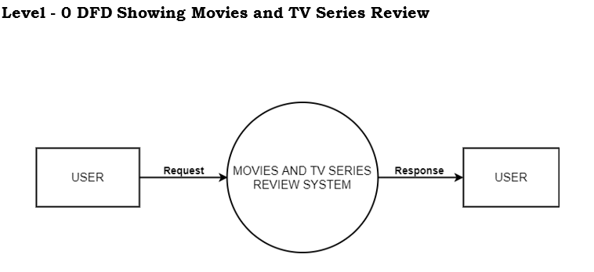

Slide 11
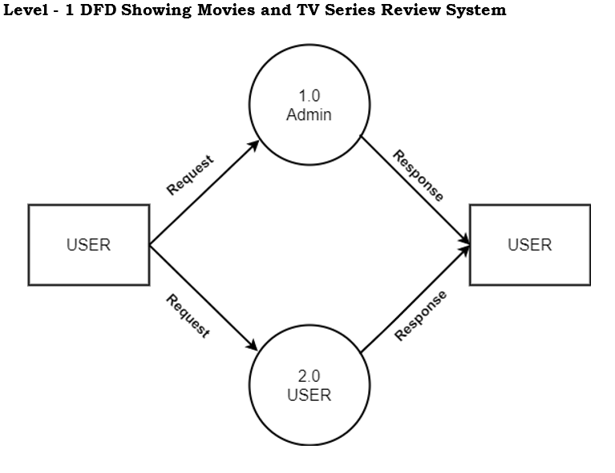

Slide 12
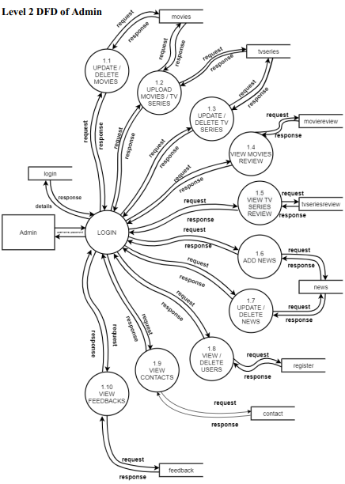

Slide 13
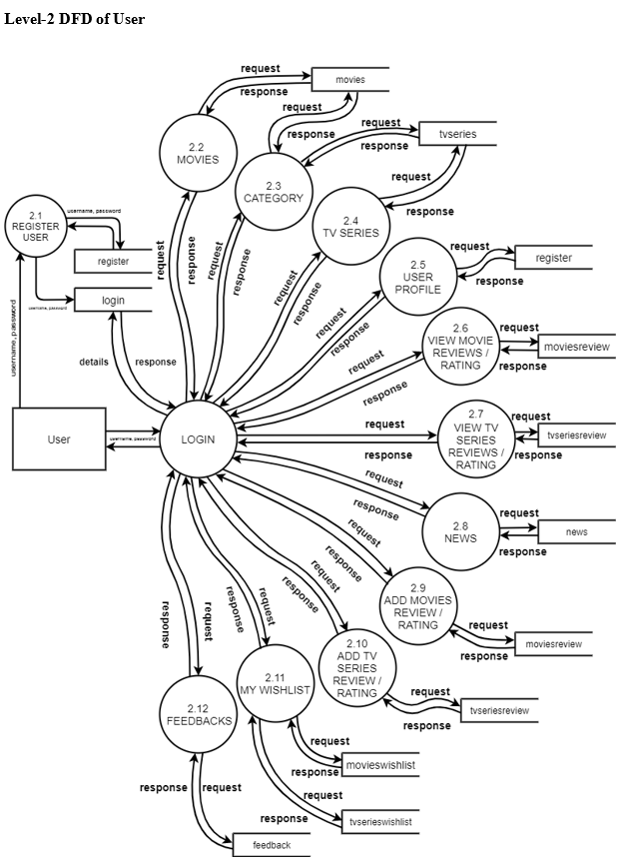

Slide 14
Project demonstration

Slide 15
conclusion
The project entitled “MOVIES AND TV SERIES REVIEW SYSTEM” provides maximum interaction and flexibility.
The system has been developed in an attractive fashion.
Finally, the system is tested with real data and everything worked successfully. Thus, the system has fulfilled the entire objective identified.

Slide 16
Any questions??

Slide 17
Thank you

